Slide 1
Team 06-SOEN 6441
Build 3
WarZone

Slide 2
Group Members:
Harsimran Kaur - 40241543
Hetul Patel - 40225667
Simran Kaur - 40221666
Parth Shah - 40196521
Mir Pasad - 40253287

Slide 3
Methodology
Game Map Details
Structure: Connected graph, nodes are territories, edges show adjacency
Continents: Subgraphs representing continents, each with a control value determining bonus armies
Gameplay: Territories belong to players and contain armies; maps can be user-defined and loaded during play
Game Mechanics
Startup Phase: Determining the number of players and random territory assignment
Main Play Phase: Turn-based, players create and execute battle orders.
Issuing and Executing Orders
Order Types: Deploy, Advance, Bomb, Blockade, Airlift, Negotiate
Reinforcement Calculation: Based on territory control and continent bonuses
Battle Simulation: Attacking and defending probabilities, territory conquest and occupation
Game End Conditions
Removal of players without territories
Game ends when a player controls all territories

Slide 4
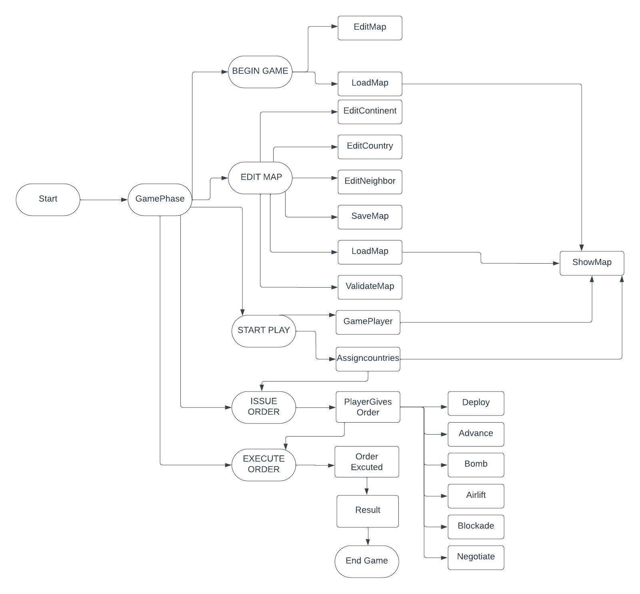
FLOWCHART

Slide 5
CODING CONVENTION

Slide 6
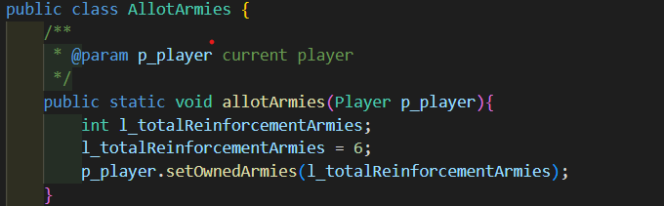
Naming Conventions
Classes - We have used UpperCamelCase.
Example:

Slide 7
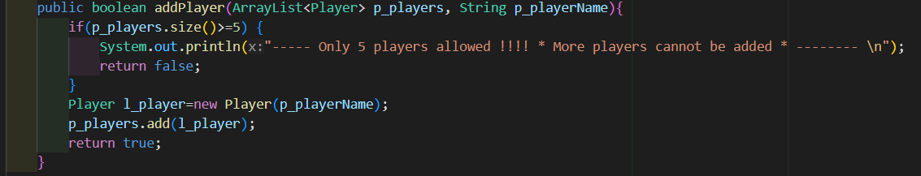
Naming Conventions continued…
b. data members, member functions, and method parameters - We have use lowerCamelCase.
• data members start with d_
• method parameters start with p_
• local variables start with l_
Example:

Slide 8
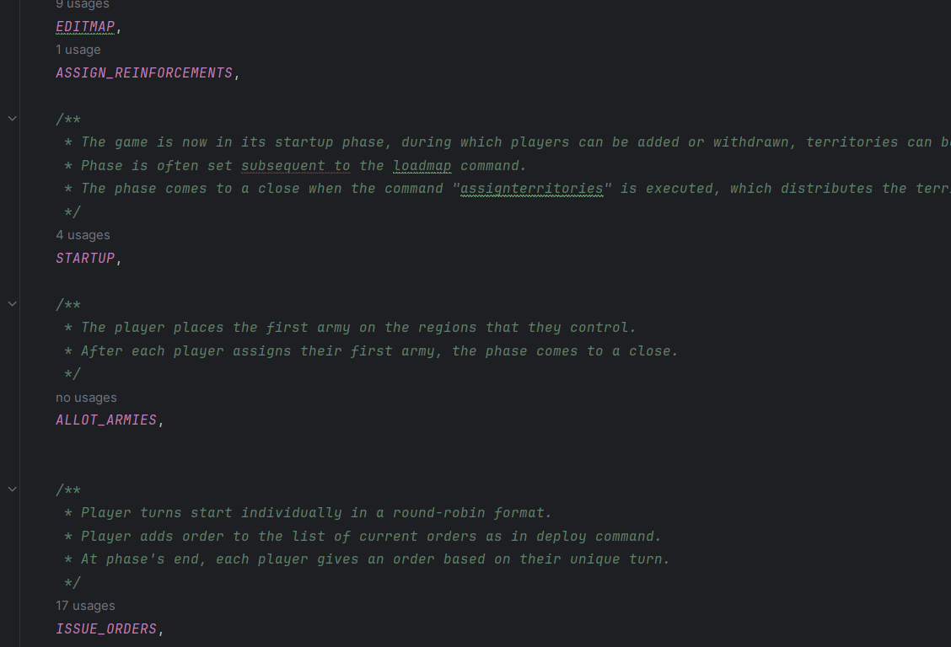
Naming Conventions Continued
c. global variables in capital letters

Slide 9

Naming Conventions continued…
c. local variables - Follow lower camelCase with "l_" prefix to denote them as local variables. Example:

Slide 10
2. Commenting Convention
1. Javadoc: All classes, data members, and member functions have Javadoc comments mentioned above them. These comments include explanations for the purpose and functionality of the class or method. Additionally, Javadoc comments include descriptions for return types, parameters, and any exceptions thrown.
2. Long Methods: Meaningful explanations has been added within long and complicated methods to improve code understanding. These explanations clarify the purpose and steps within the method to aid in comprehension.
3. No Commented-out Code: Unnecessary commented-out code has been removed from the codebase to enhance readability and maintainability.

Slide 11
Thank You

